Slide 1
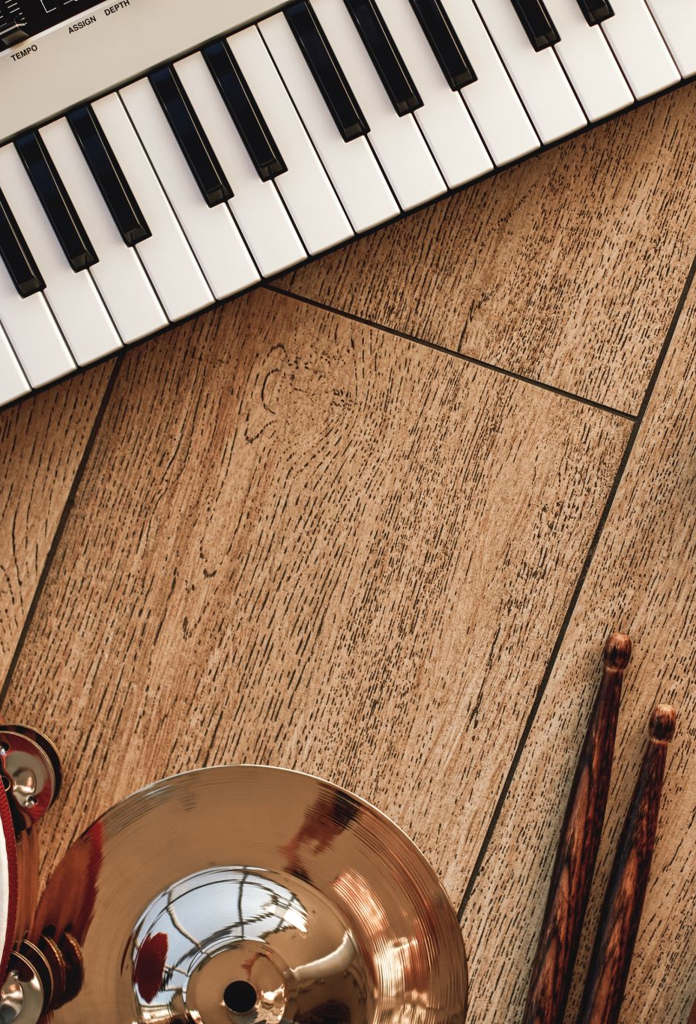
Music Genre Classification
Kavya Sree Soma- kavyasree_soma@student.uml.edu
Vagdevi Nandimandalam- Vagdevi_Nandimandalam@student.uml.edu
Arun Kumar Coimbatore Dada- arunkumar_coimbatoredada@student.uml.edu
Udith Lakshmi Narayan- fnu_udithlakshminarayan@student.uml.edu
Anurag kalapala- Anurag_kalapala@student.uml.edu

Slide 2
Music genre classification is important in many applications such as music recommendation systems, content organization, and personalized user experiences.
It becomes possible to automate the process of playlist construction, music streaming recommendations, and personalized content distribution for consumers with varying musical interests by precisely categorizing music into various genres.
By using appropriate machine learning algorithm, we can successfully classify music genres based on features derived from audio data, allowing for the development of accurate and dependable music genre classification systems.
Background
Information

Slide 3
Problem Statement
Given the varying and subjective nature of musical genres, the problem at hand is to create an efficient and accurate Music Genre Classification system capable of automatically categorizing audio records into various genres.
This involves feature extraction from audio files, data preprocessing, and selecting two distinct machine learning algorithms to train and evaluate their performance in genre classification.

Slide 4
DATA SOURCE
Download GTZAN Dataset from: https://www.kaggle.com/datasets/andradaolteanu/gtzan-dataset-music-genre-classification
Raw data is 1.2GB. The GTZAN Genre dataset is a comprehensive collection of 1,000 audio tracks, each of which has a duration of 30 seconds.
It is systematically categorized into 10 distinct musical genres, with each genre encompassing 100 tracks.
The genres represented are Blues, Classical, Country, Disco, Hip hop, Jazz, Metal, Pop, Reggae, and Rock.

Slide 5
What is Data Preprocessing:
Data preprocessing in machine learning involves cleaning, transforming, and organizing raw data to make it suitable for analysis.
It includes tasks such as
handling missing values
Image resizing and Normalization
Shuffling and Batching
Caching

Slide 6
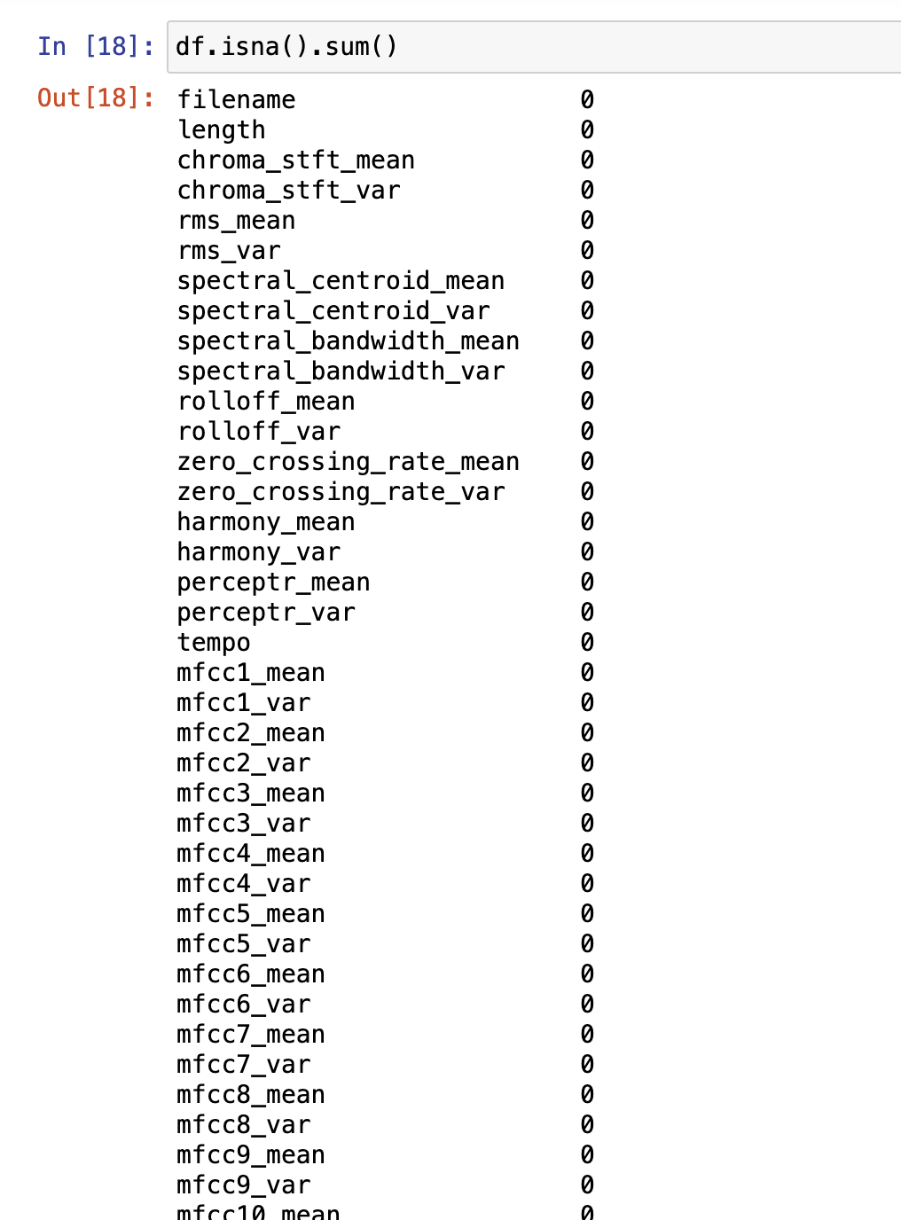
IMPLEMENTING DATA PREPROCESSING
check for missing or NaN (Not-a-Number) values in a Data Frame df and count the number of missing values in each column.

Slide 7
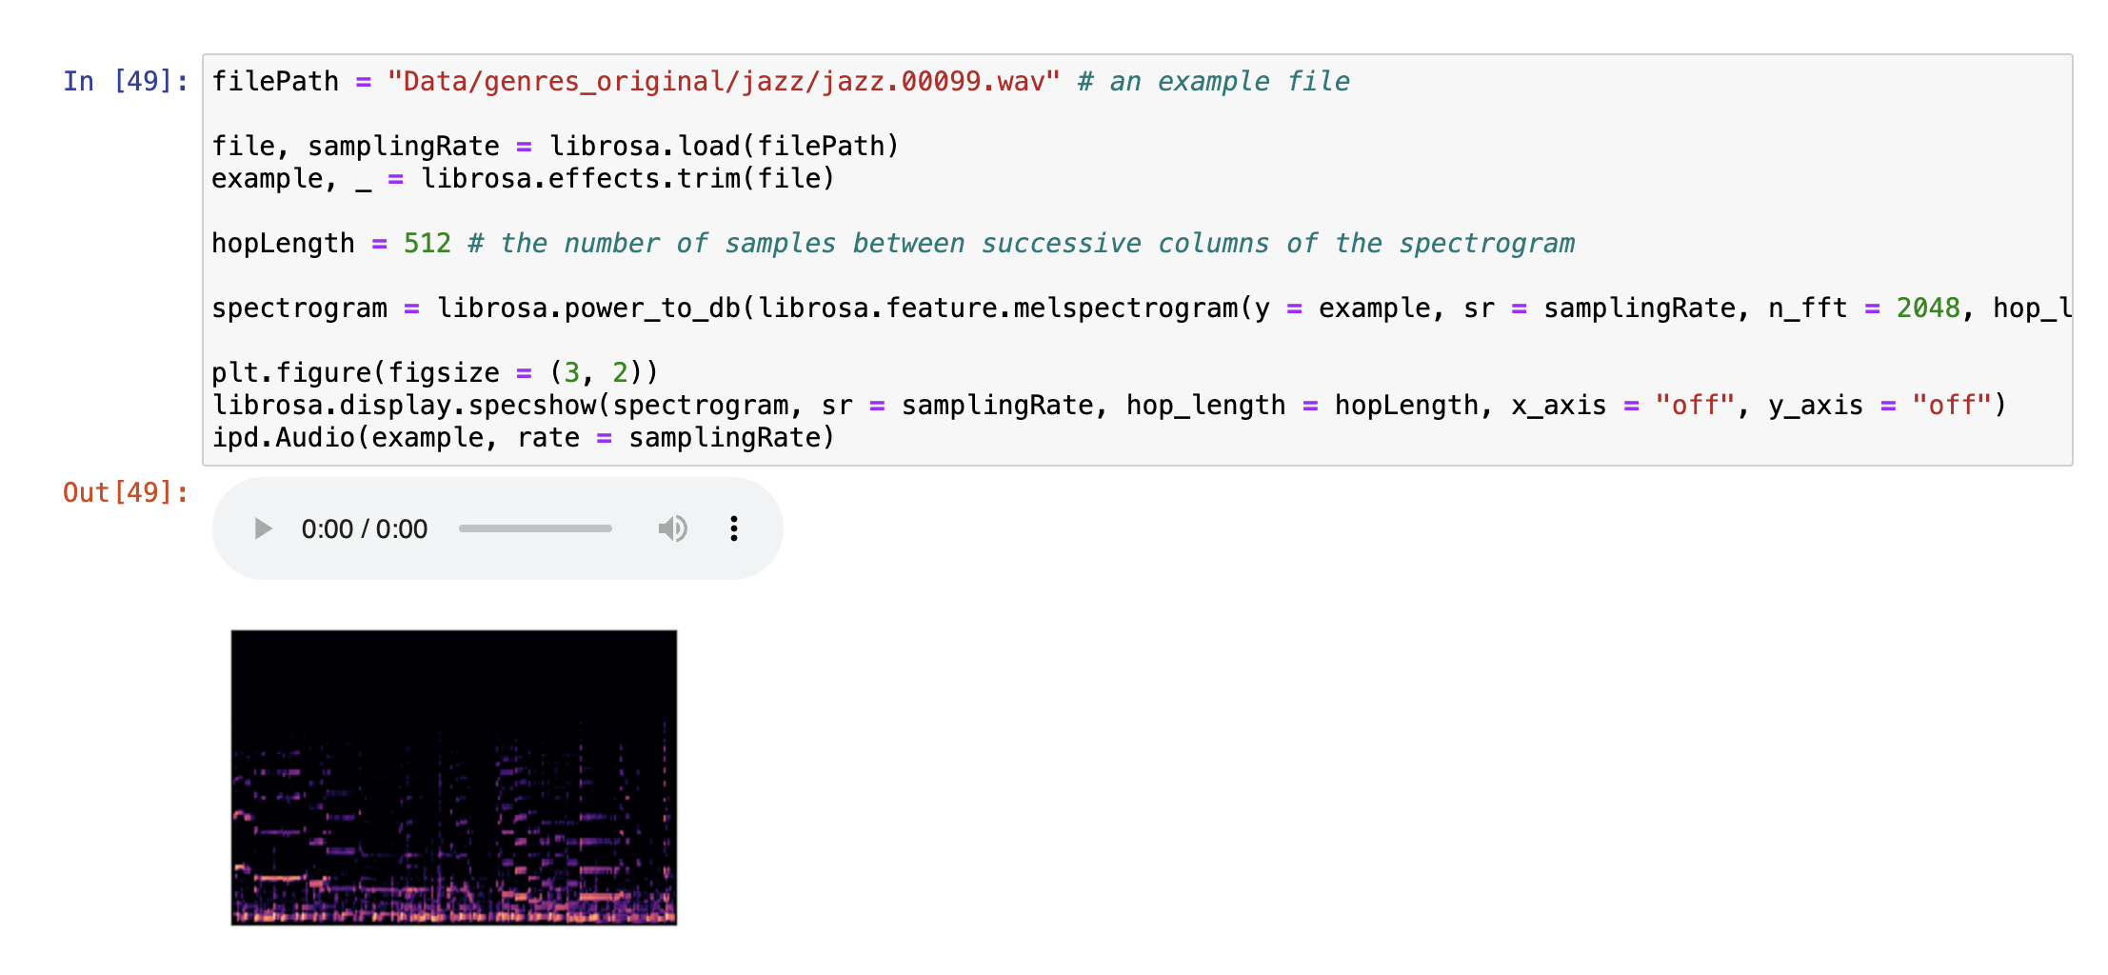
PREPARING DATA
Remove any leading and trailing silence from the audio signal. Compute a Mel spectrogram from the trimmed audio.
A spectrogram represents how the power in different frequency bands changes over time.

Slide 8
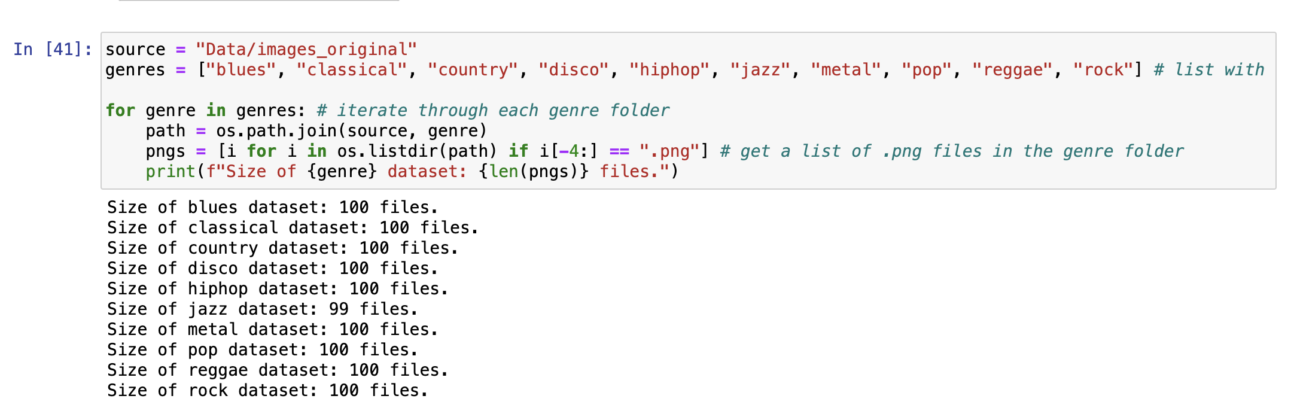
REMOVING ERRONEOUS VALUES
To ensure that the dataframe is consistent and will not cause errors in the future, we need to check for null or missing values.

Slide 9
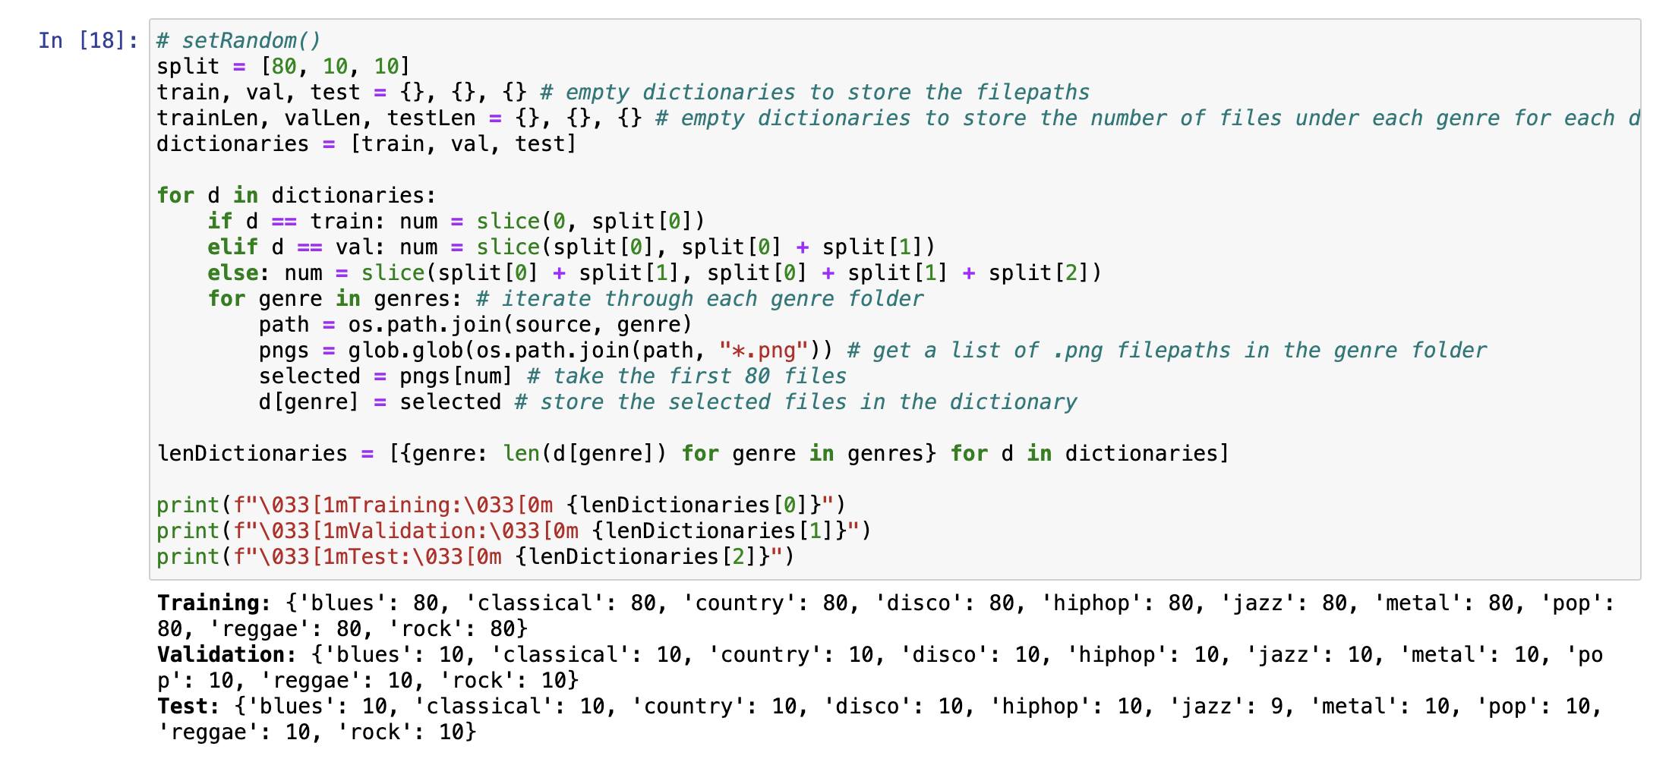
SPLITTING THE DATA
Dividing the available data into 3 subsets - namely training, validation, and testing.
We have chosen an 80:10:10 split for my training, validation and testing data respectively, as you can see from the dictionaries outputted below

Slide 10
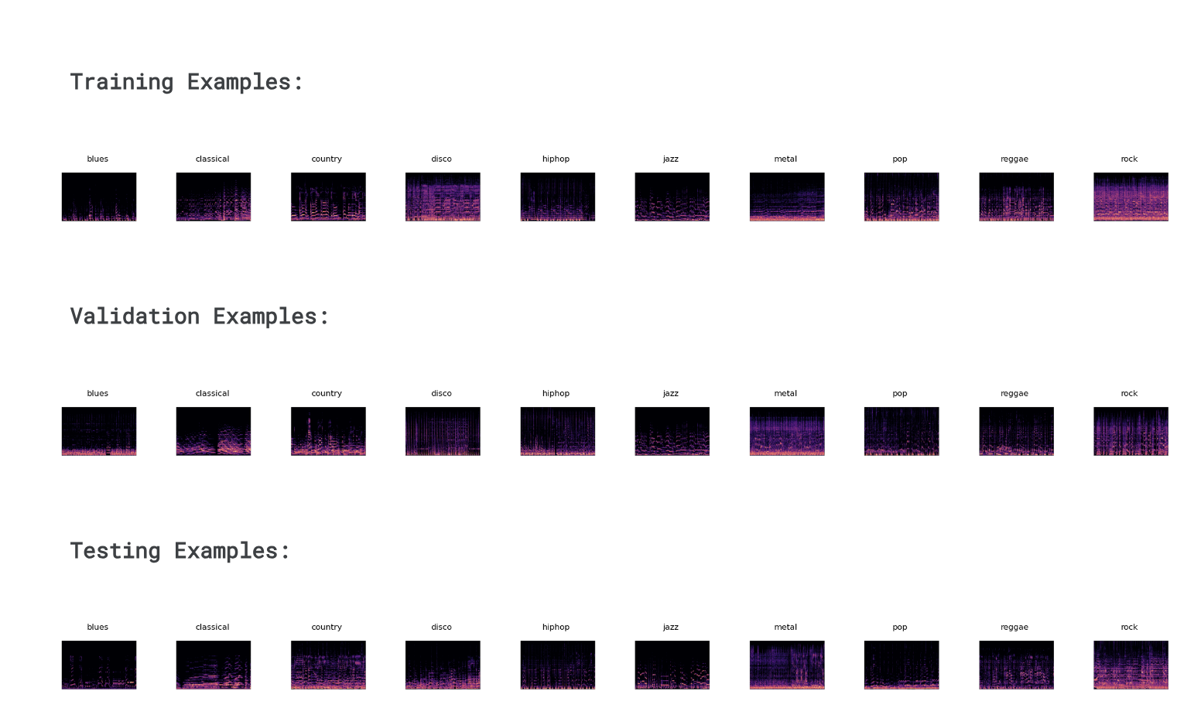
DATA FORMATING
Here are some examples of the spectrograms in each genre for each dataset.

Slide 11
Methodologies Used
KNN
CNN
CNN-RNN

Slide 12
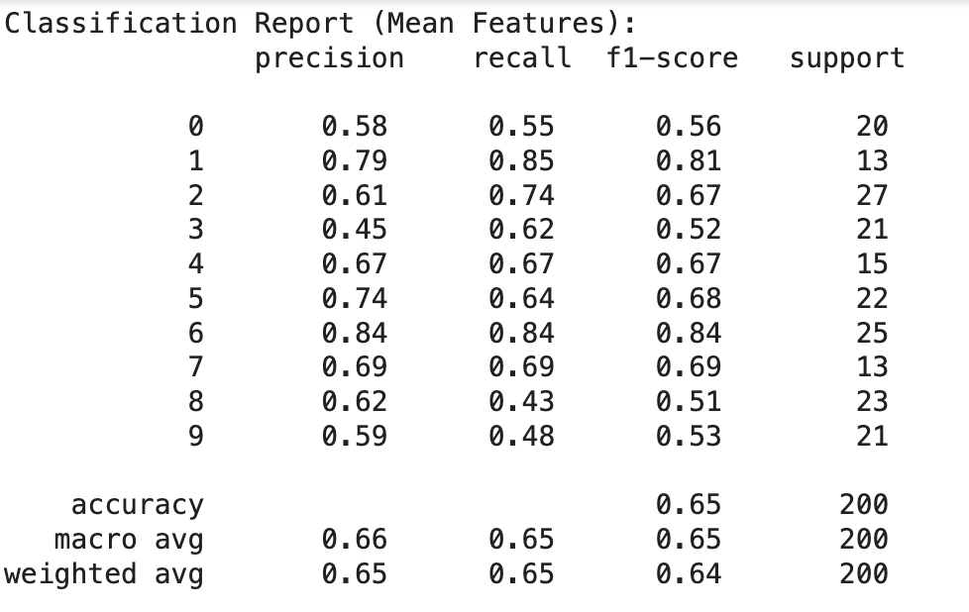
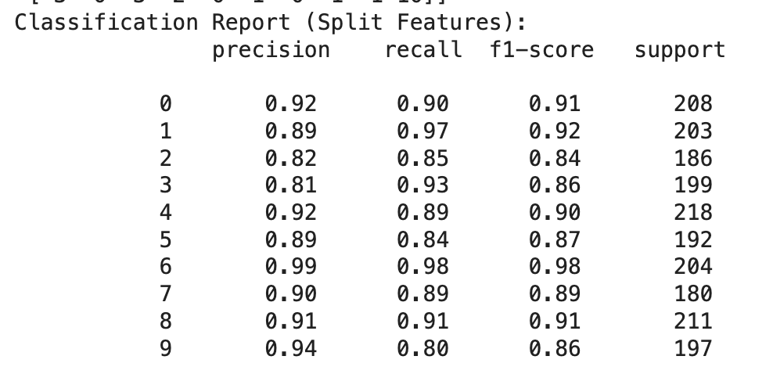
KNN
Comparing the classification report for KNN Mean features and Split Features

Slide 13
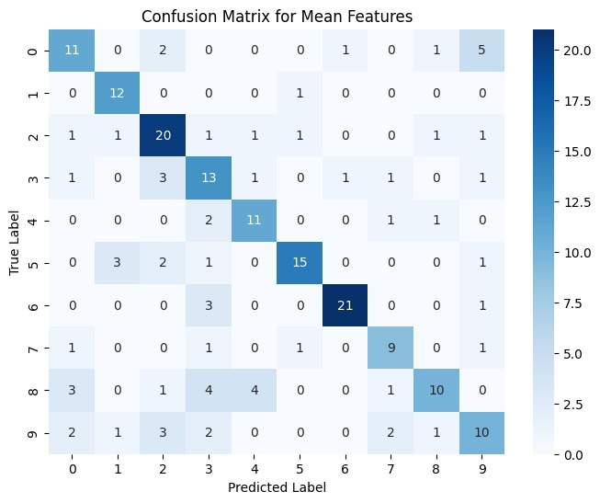
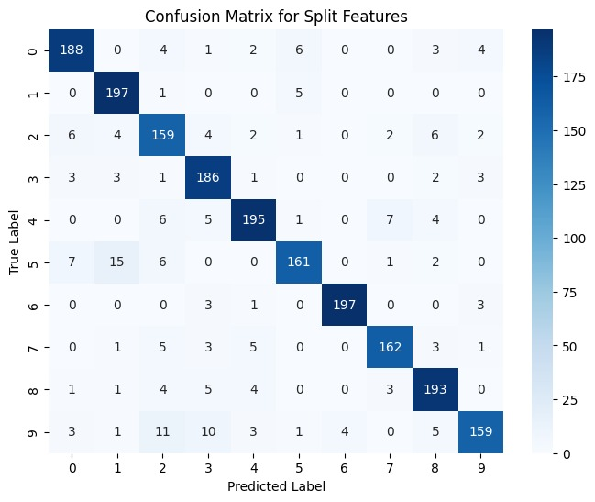
Confusion Matrix (Split Features)
Tried for different K values but obtain the highest Accuracy when the K value is equal to 4.

Slide 14
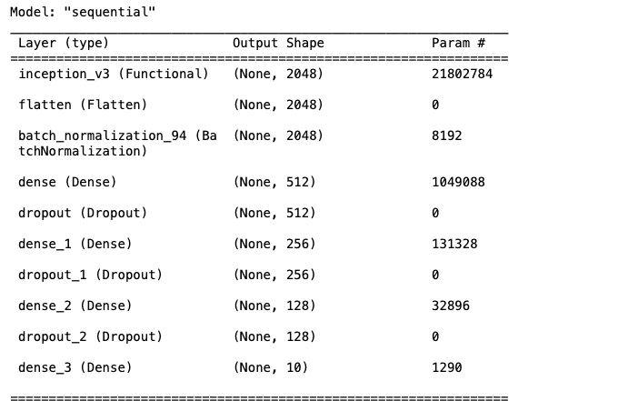
Neural Network

Slide 15
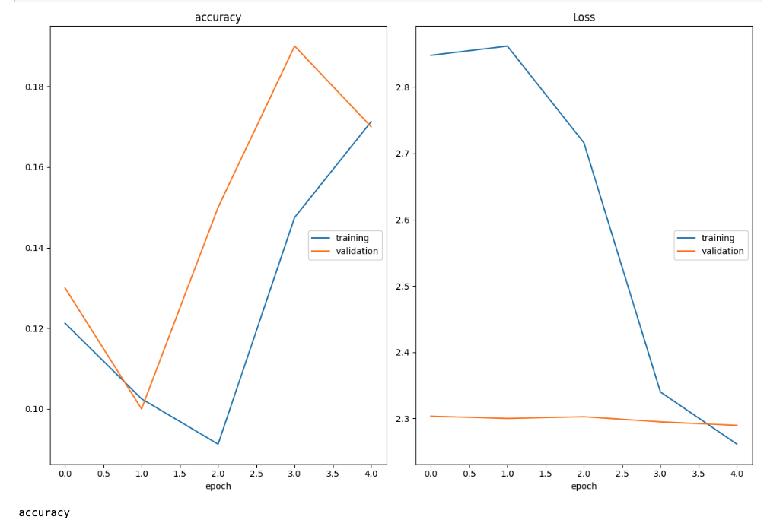
Accuracy and Loss

Slide 16
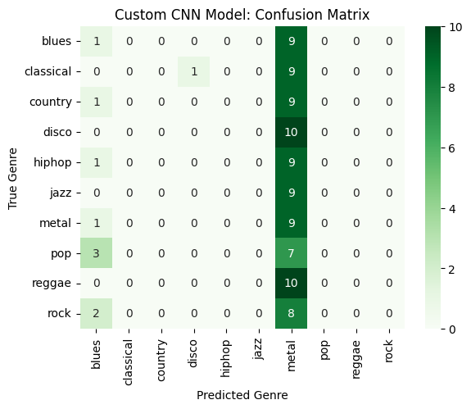
Confusion Matrix

Slide 17
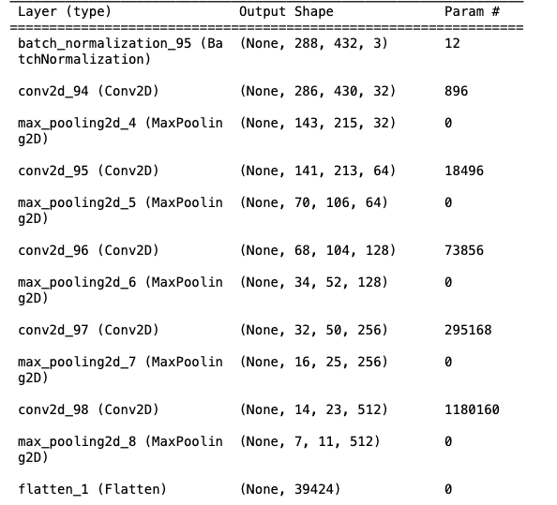
Convolution Neural Network

Slide 18
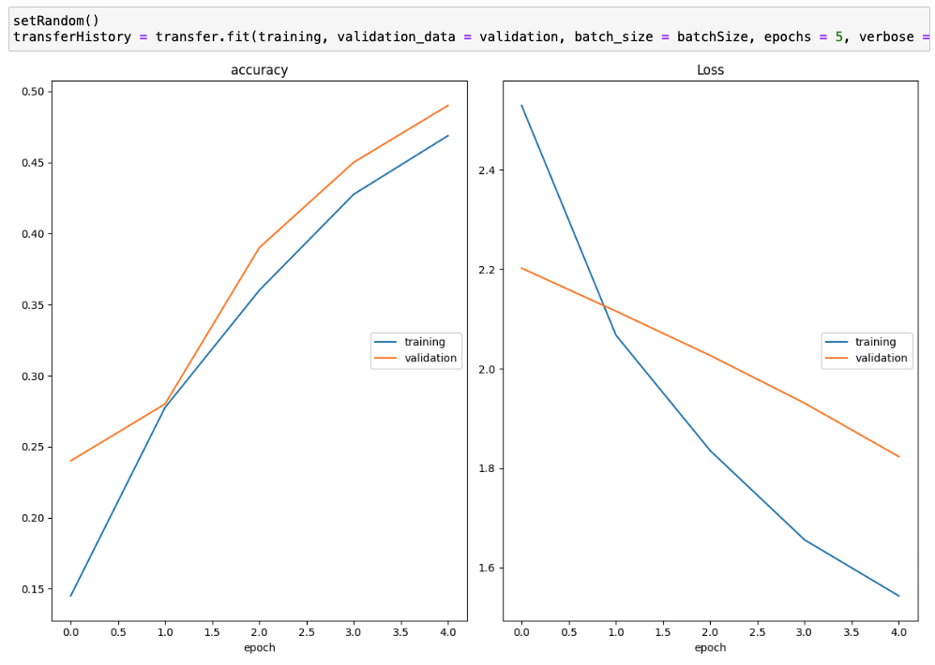
Accuracy and Loss for CNN

Slide 19
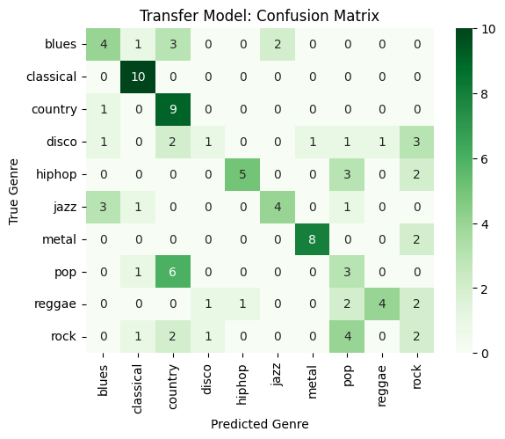
Confusion Matrix for CNN

Slide 20
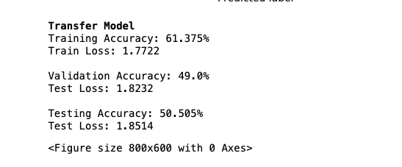
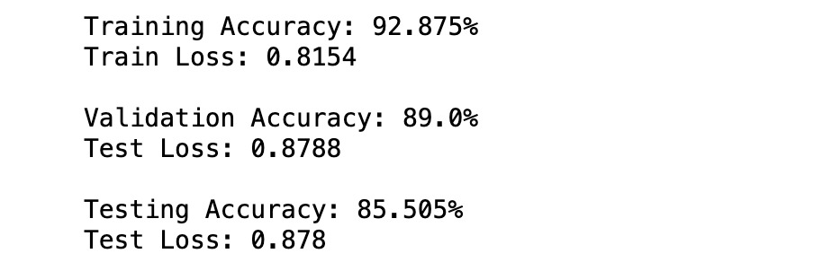
Comparing the Accuracy and Loss for Dense Network and Convolution Neural Network
Neural Network
Convolution Neural Network

Slide 21

what new we have implemented? (CNN)
Increased depth and complexity by adding more layers.
Expanded neuron counts in fully connected layers for improved feature representation.
Adjusted filter dimensions to capture diverse image features effectively.
Experimented with different activation functions to optimize learning.
Employed regularization techniques like dropout and batch normalization.

Slide 22

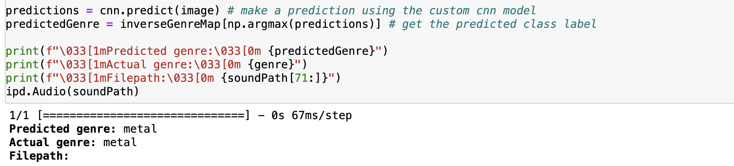
Tested with one of the music track

Slide 23
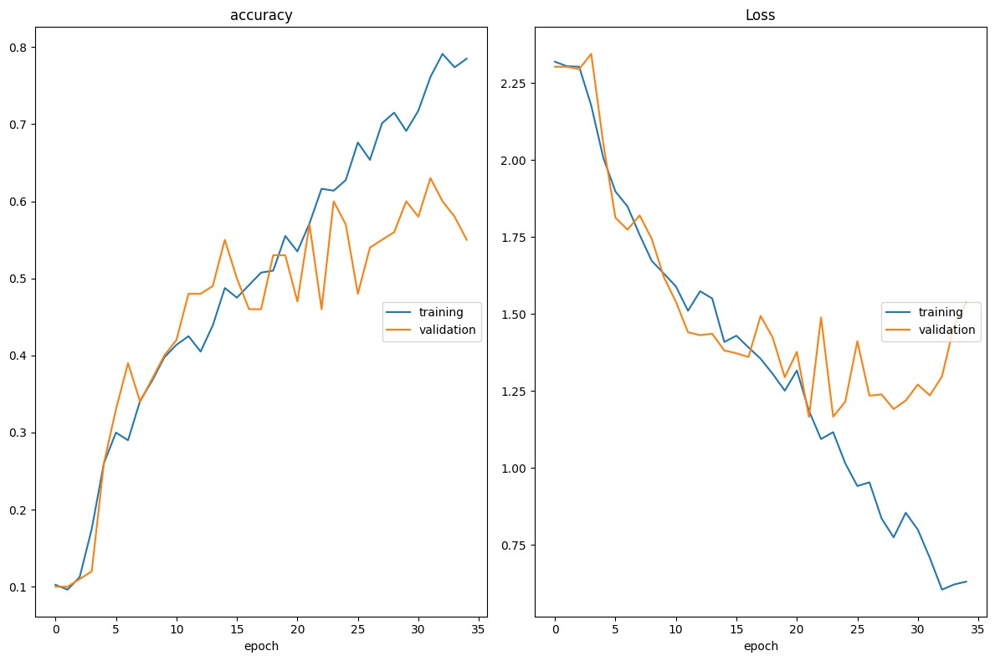
CNN-RNN

Slide 24
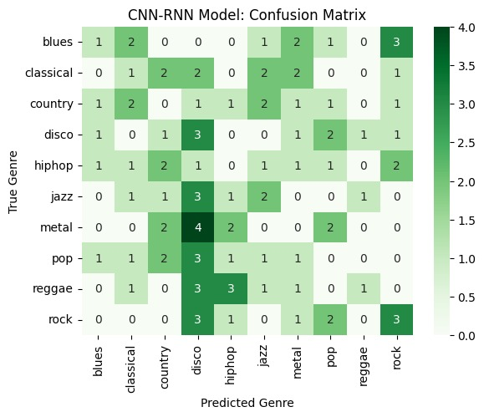
Confusion matrix for CNN-RNN

Slide 25

CNN-RNN Model
Accuracy: 80.0%
Train Loss: 0.5617
Validation Accuracy: 55.0%
Test Loss: 1.5372
Testing Accuracy: 56.5657%
Test Loss: 1.4318

Slide 26
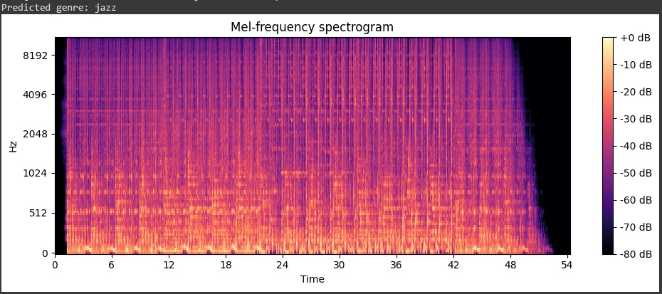
Testing the CNN-RNN model

Slide 27
Conclusion
From the results of the different classifiers, we can see that the CNN classifier performed the best with an accuracy of 85%. This classifier was followed by KNN classifier, which had an accuracy of 82%.
Overall, the CNN approach was able to improve the performance of the model.

Slide 28
Thank you

